Slide 1
The Habitat of Crime
Examining the Spatial and Demographic Characteristics of Chicago Crime to Inform Resource Deployment

Slide 2
Introduction
Introduction
As an outgrowth of the baser human instincts, crime can be equated to a living and malignant organism. Similar to other parasites, there are specific factors that nourish its growth and structurally unique environments that it will prefer.
The purpose of this analysis is to determine significant structural, demographic, and temporal factors that contribute to local crime rates. Once understood these patterns could be used to guide investments and/or inform policing patterns.
Initial Spatial Hypothesis:
Crime rates (as measured by crime count/〖km〗^2) decrease as one moves closer to a police department
This assumes police presence is a deterrent to crime. It also assumes that its deterring effect is strong enough to overcome any increase in proactive arrests due simply to increased patrol frequency.
Note: for the sake of simplicity I assume that each police department employs the same number of officers. This could be tightened with actual weights.
Crime rates increase as one moves closer to a transit station.

Slide 3
Data
The superset of data is a combined set of files including the following:
Chicago crime data
Geo-spatial polygons
Mass transit station locations
Police department locations
Demographics
Crime Categorization tables
Weather data.
In order to retain as much data as possible but make the content of this analysis more intuitive, each primary type of crime has been mapped to a “Meta Category.” These meta categories were created by grouping crime descriptions as closely to federal definitions as possible with provided data. Categories are as follows:
Violent Crimes
Criminal Sexual Assault
Homicide
Etc.
Non-Violent Property Crime
Burglary [ex Home invasion]
Motor Vehicle Theft
Etc.
Financial Crime/Fraud
Deceptive Practices [embezzlement, etc.]
Money Laundering
Etc.
Other
Traffic violatons
Non-violent narcotic violations
Etc.
Hour Categories are split into 4 hour increments as follows:
7am - 11am is “AM Commute”
11am - 3pm is “Lunch”
3pm - 7pm is “PM Commute”
7pm to 11pm is “Evening”
11pm - 3am is considered “Night”
3am – 7am is considered “Pre Dawn”

Slide 4
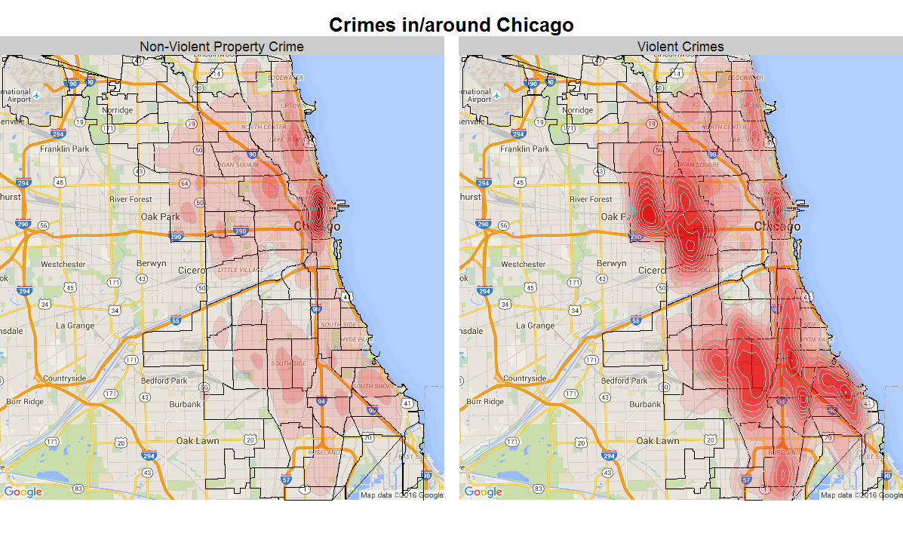
A View of Chicago Crime
The following is an overall image of Non-violent Property Crime and Violent Crimes around Chicago.
Property crime is highly focused downtown with a few moderate hot spots elsewhere. Violent crime is widely dispersed with multiple hot zones.

Slide 5
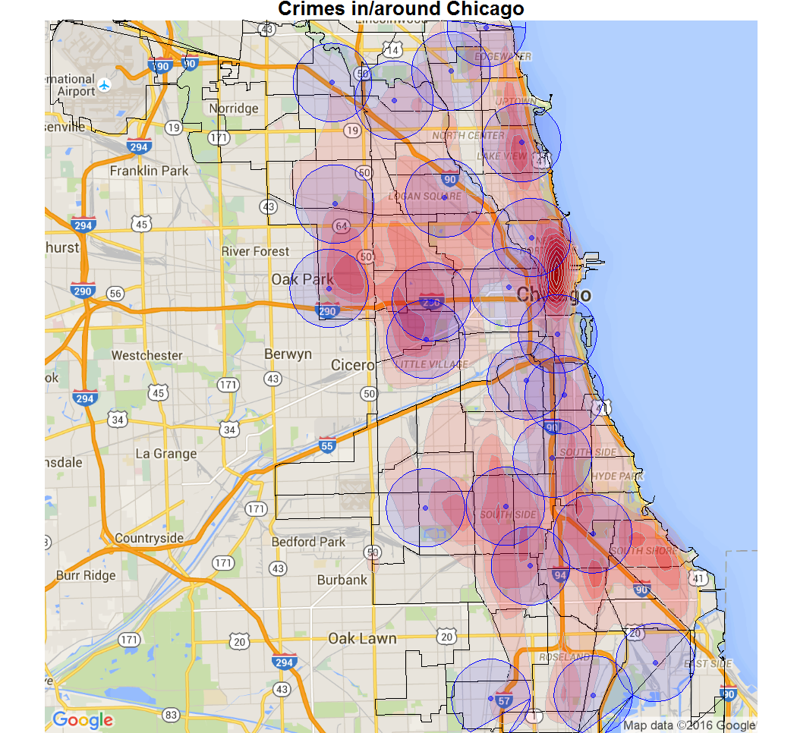
Heat Map with Police Stations
The following heat map shows police departments as markers with 2km patrol zones drawn around each one. Any proximity effects would likely be de minimis beyond that range [if there are any at all]. The black borders denote community boundaries.
PDs are typically not located at local peaks.
If police presence were a strong deterrent, it would likely create more prominent dips in the areas immediately surrounding stations.
Chicago Crime Density with Police Department Markers and 2km Patrol Zones.
Notes:
It would be interesting to contrast crime patterns in these areas before and after each PD was built. Assuming one controlled for any changes in population/demographics, changes in local crime rates could corroborate patrol effectiveness and/or the hypothesized deterrent effect. Without that data one can only examine the current spatial characteristics.

Slide 6
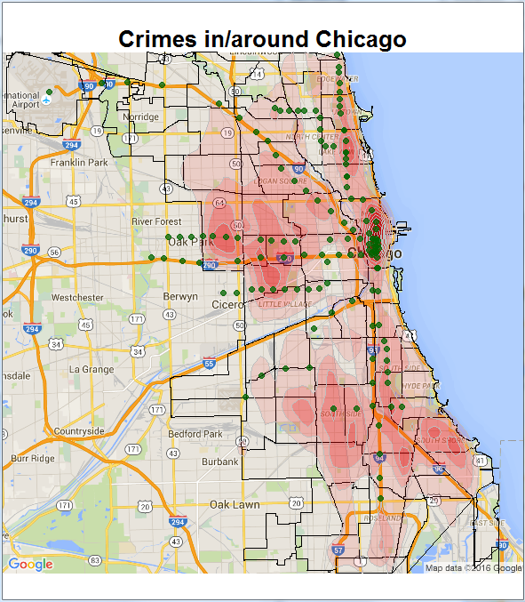
Heat Map with Transit Stations
A transit station overlay (as represented by the L train) shows distinct overlap between common transportation avenues and crime rates. This is not enough to confirm the hypothesized relationship between transit proximity and spatial crime rates, but it is a promising initial picture
Transit Patterns seem to closely mirror crime patterns or vice versa.
Transit systems provide criminals with easy/distracted targets, anonymity, and built-in escape routes.
Given a relatively mobile culture, community transit characteristics may be a stronger predictor of crime rate than traditional demographics.
Chicago Crime Density with Transit Station Markers

Slide 7
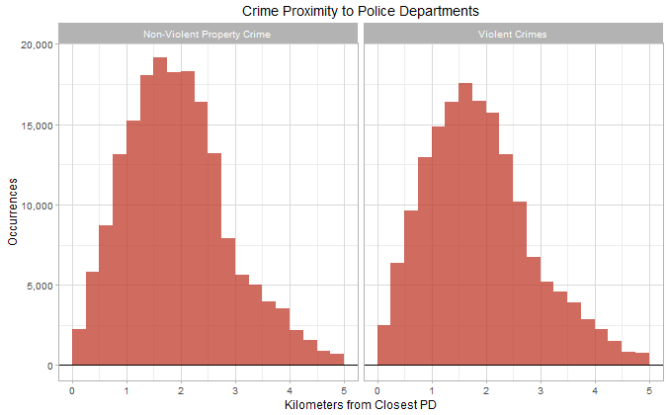
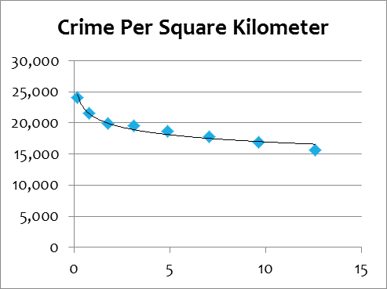
Proximity to Police Stations
Contrary to the initial hypothesis, crime rates do not decrease as one gets closer to a given police department. While the effects are not extreme, Violent Crime and Non-Violent Property Crime rates actually increase:
While area shrinks 98% from a 2km radius to a ¼ km, density increases by 54%.
This does not negate the theory that police presence acts as a deterrent. However, if it is a deterrent as one would expect, that effect is not strong enough to offset more frequent patrols.
To prove or disprove deterrent effects, one would need to contrast crime patterns around a given PD before and after being built.
Notes:
This could be viewed as a success. I.e. patrols have been a relatively effective approach to confronting crime.

Slide 8
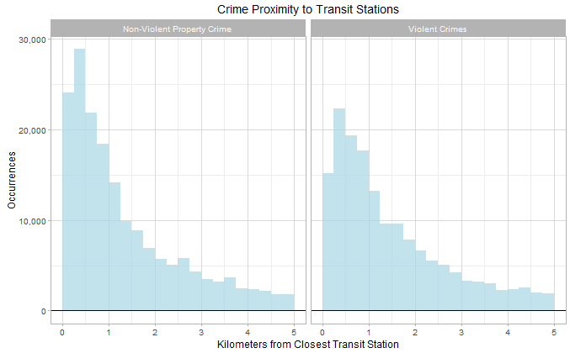
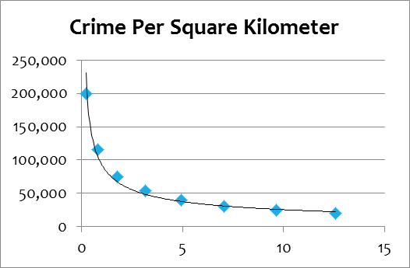
Proximity to Transit Stations
For mass transit locations the initial hypothesis appears to be correct. Crime rate (density) clearly increases as one moves closer to a given transit station.
Density increases by 913% as one moves from 2km to a 1/4 km from a given transit station.
This effect starts to flatten out beyond 2 square kilometers.
Notes:
This could be further refined with more transit related data such as bus stops and/or volume estimates. Regardless, it is clear that any future infrastructure investments and patrol assignments must account for a city’s transit characteristics.

Slide 9
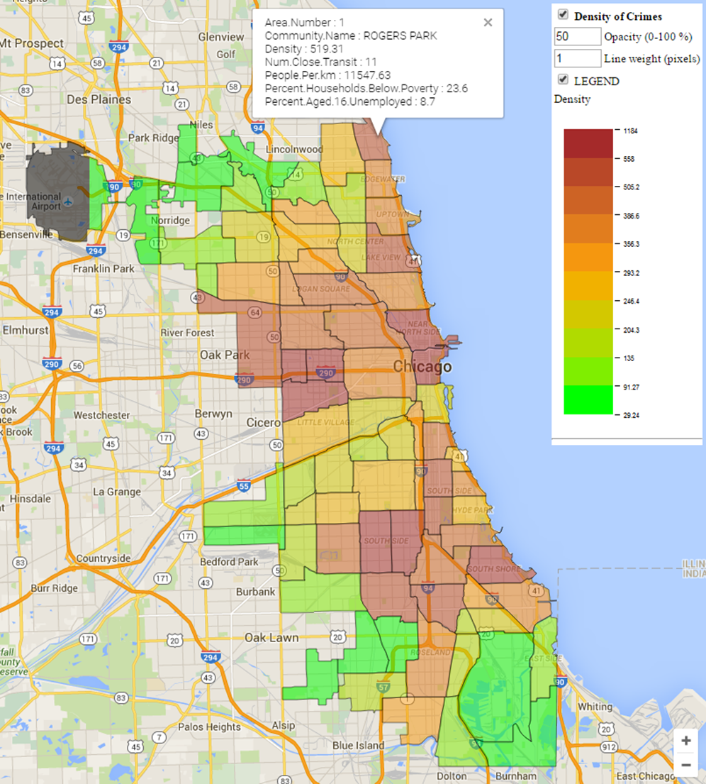
Density @ the Community Level
Given the structure and political influence of community organizations, it may prove equally useful to view crime rates and any resource deployment recommendations bounded by community borders. The following choropleth displays Chicago communities according to increasing crime rate as measured by annualized crime rate per square kilometer.

Slide 10
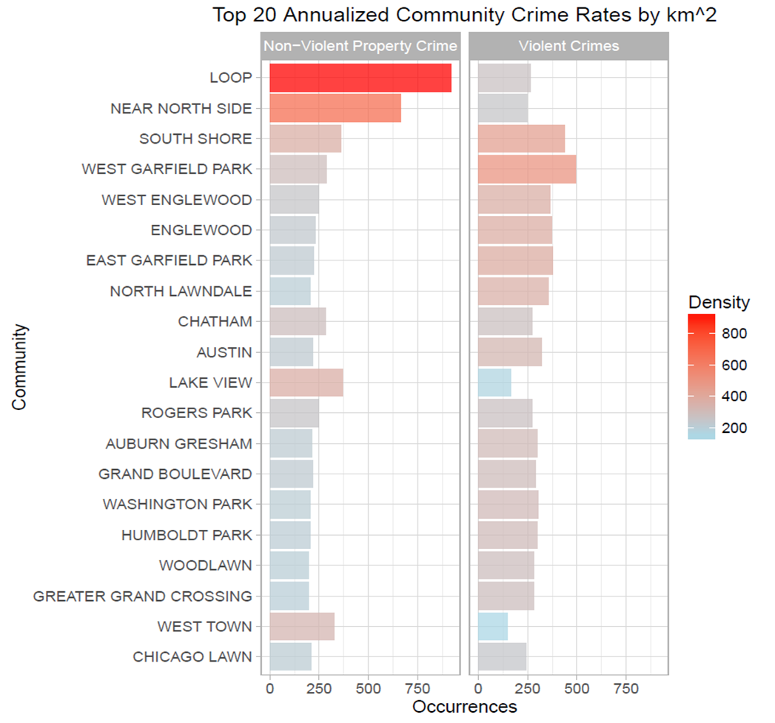
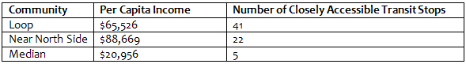
Density @ the Community Level
The following bar graph shows the 20 communities with the highest density ratings. It is ordered by a community’s overall crime density and then split out to show Non-Violent Property Crime separate from Violent Crimes.
Some communities, like the Loop and the Near North Side, are very crime dense and have a markedly one-sided make-up of crime that traditional demographic factors like income would not have predicted.
Per the section on community demographics below, mass transit locations may be a better predictor of crime rates than traditional demographic factors.
Notes:
Both of these communities in particular are relatively affluent with per capita incomes of $65,526 and $88,669, respectively; however, they have a very large number of accessible mass transit locations within their communities.

Slide 11

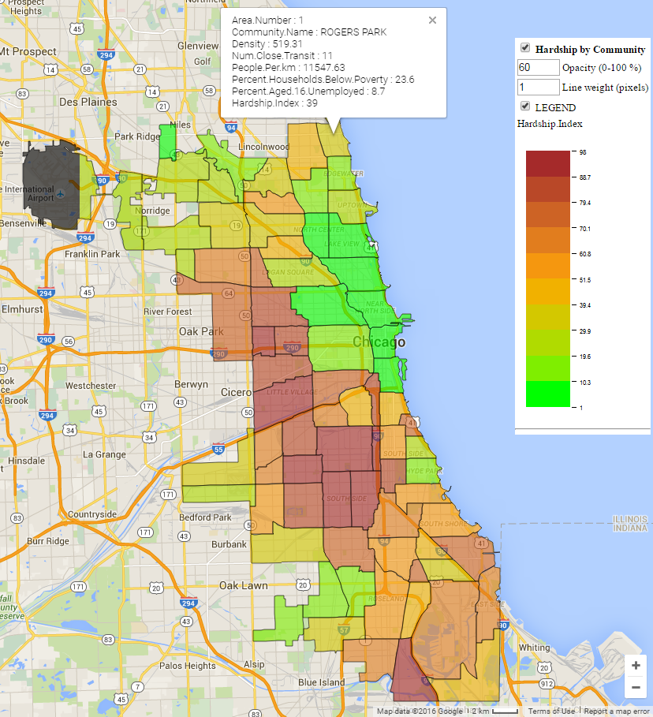
Density @ the Community Level
Using another metric, one could contrast crime density by community to the same map colored by community hardship. Note how hardship is not a tremendous predictor of crime. See the next section for a deeper dive on community demographic factors.
Crime Density
Hardship Index

Slide 12
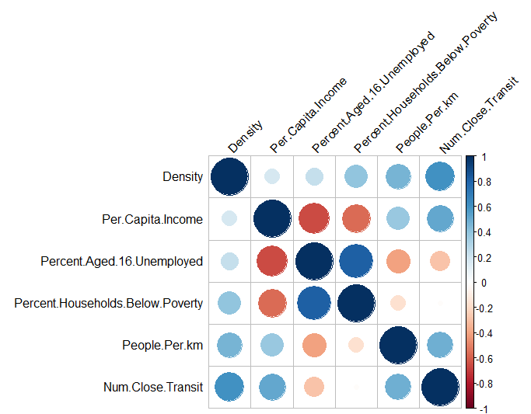
Demographics and Other Community Level Characteristics
There are a number of demographic factors typically thought to cause higher crime rates. These include increased population density, lower relative income, unemployment, and poor or incomplete education. This analysis explored each of these metrics at the community level.
To summarize findings, only 3 of the chosen demographic factors were significantly correlated to a community’s spatial crime rate
The number of transit stations accessible to a given community is more highly correlated with spatial crime rates than any of the demographic variables.

Slide 13
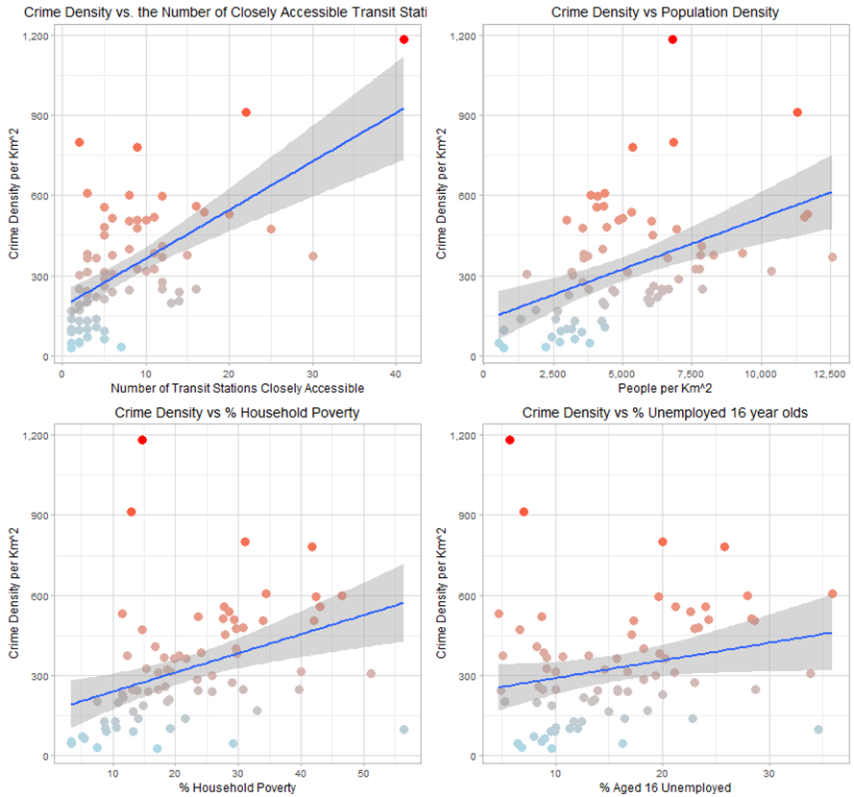
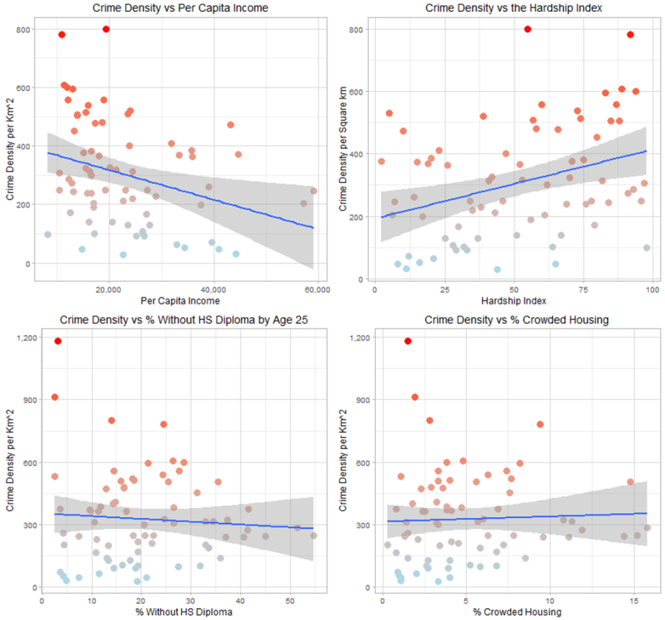
Demographics and Other Community Level Characteristics
The following graphs illustrate these relationships in order of decreasing correlation and significance.
Notes:
There is some co-linearity between “% Households Below the Poverty Line” and “% Aged 16 Unemployed” [corr = 0.81] as well as “#of Transit Stations” and “Population Density” [corr = 0.48].
This will dictate choosing the more significant factor of each pair for regression modeling. I.e. “% Households Below the Poverty Line” and “#of Transit Stations.” See the modeling section below.

Slide 14
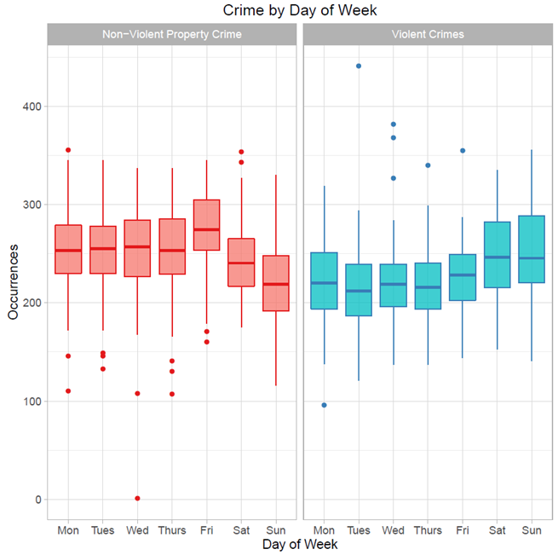
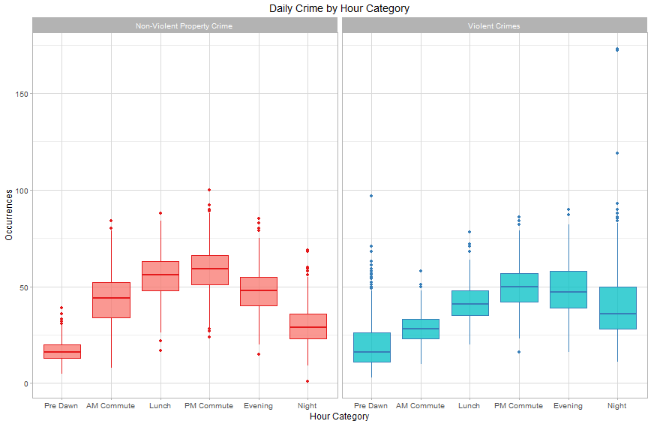
Proximity to Transit Stations
Beyond the spatial characteristics of crime, the city must efficiently deploy its resource on a daily and even hourly basis. While there is some variance within meta-categories, it does not appear that overall crime rates differ substantially by day of week; however, they do by hour.
The daily distribution of crime does not appear to have a statistically significant effect within regression models, but the hourly distribution does.

Slide 15
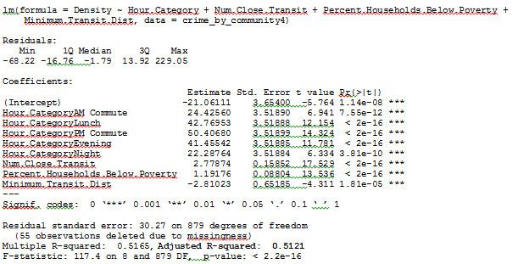
Modeling
The following model examines the relationship between a given community’s crime density and those factors from the above analysis that were most significant after taking co-linearity into account. These are as follows:
Hour Category
The # of Transit Stations in Close Proximity to a Given Community
% Households Below the Poverty Level
Minimum Distance to a transit Station (as a proxy for access to any public transportation)
Within a given year and hour category, a model based on these few factors can explain 51% of the annual variance in community spatial crime rates.
Each of the above factors is statistically significant. As one might expect given the correlation graphs in section 6, a community’s transit characteristics appear to have a greater effect on crime density in Chicago than more traditional demographic predictors.

Slide 16
Introduction
Summary of Findings
Using data from 2013-01-01 to 2014-12-31, crime rates do not decrease but actually increase as one gets closer to a police station.
This evidence is not enough to invalidate the hypothesis that police presence is a deterrent. Given the intuitive nature of that assumption, the pattern may simply underscore the effectiveness of proactive policing. E.g. that patrols are effective enough to overcome the natural deterrent one would otherwise expect from increased police presence.
Crime rates increase exponentially as one approaches a transit station, and a community’s transit characteristics may be more effective at predicting crime rates than traditional demographics.
Spatial crime rates do not necessarily follow the traditional demographic factors in Chicago.
The distribution of crime does not vary dramatically by day of week, but it does by hour. Patrols should be organized accordingly

Slide 17
Introduction
Conclusion
Infrastructure and Patrol Proposal
Increasing police presence near transit stations will give police the best chance to affect crime in their areas. The city could accomplish this with frequent patrols tightly centered on transit stations or by setting up small, permanent outposts at their most affected stations. Either strategy could increase patrol efficacy while having a targeted effect on demonstrated hot spots. While permanent outposts would be the more capitally intense option, regular assignments to these posts could have the added benefit of improving community relations through personal familiarity.
Proposal for Further Analysis
Chicago is “off to [its] deadliest start in nearly two decades.” Homicides and shootings are up by more than 70% compared to 2015, while arrests and investigative stops have decreased. The reasons for these shifts are beyond the scope of this analysis. However, a time lapse analysis could shed some light on growth patterns. If the client wishes to move forward, I would suggest the following:
Add additional transit station locations and volume estimates for each location. E.g. bus routes
Add Police Station employee data
Add additional community and/or demographic data
Perform temporal analysis showing acceleration/deceleration of crime rates per community to understand trends.
Temporal (Schedule) Conclusions
Unless patrol teams are divided by type of crime, patrol schedules do not need to adjust for day of week volumes. There are, however, strong shifts in hourly volume and staff should be scheduled accordingly.
Proposal for further analysis
Perform more in depth resource deployment analysis using to determine workforce requirements on an hourly basis per police district.
Examine Holiday effects on crime.
Expand prediction models to include other variables that could assist with scheduling decisions such as weather.
Notes:
It would be worth running a few trials in the city’s most crime dense communities to determine effect. Per the choropleth and bar graphs in the community section of this paper, a trial in West and East Garfield could be used to gauge effects on Violent Crimes while a trial in the Loop and the Near North Side could be used for Property Crimes. Trials in these areas should help isolate any effects that the strategy has on Violent Crimes vs. Non-Violent Property Crime.

